Slide 1
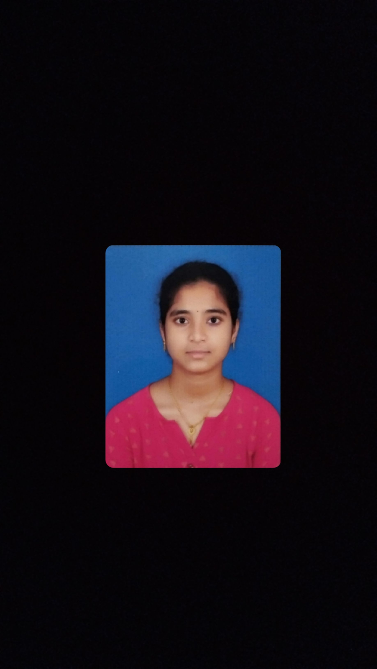

STUDENT DETAILS
Name : Challapalli Harshapriya
Skills-build Email ID: harshapriya2745@gmail.com
College Name: Sir C R Reddy College Of Engineering
College State: Andhra Pradesh
Internship Domain & Internship Start & End Date:
Cyber Security / 3rd June 2024 – 15th July 2024

Slide 2
STEGNOGRAPHY
TOPIC : HIDING MESSAGE IN AN IMAGE
Objective: The objective of the project is to develop a robust steganographic system for hiding messages in images, ensuring security and non-obviousness.
Problem Statement
Traditional encryption can be easily intercepted. Steganography provides additional security by hiding information in images, making them less likely to be detected.
The challenge is to embed the messages without significantly altering the visual appearance of the images, and to ensure that the changes are not invisible to the human eye.

Slide 3
AGENDA
The main concept of this project is to “Hiding a secret message in an Image”.
Using the Steganography Techniques we are implementing a code in python to deploy this project.
In this project the main library we used is “OpenCV ”.
The open cv library has many inbuilt functions for Image processing.

Slide 4
PROJECT OVERVIEW
Steganography is the art and science of concealing information within other data to avoid detection. When applied to images, it involves embedding a secret message within the pixels of an image without visibly altering its appearance.
Steganographic Technique used :
XOR Operation
The binary values of the cover image pixels are XOR-ed with the binary values of the corresponding bits in the secret message.
This can be done sequentially, bit by bit, or by dividing the cover image and secret message into blocks and performing XOR operation on each block.

Slide 5
WHO ARE THE END USERS of this project?
It can be used by anyone who wants to keep their information private and secure. Some common end-users of steganography include:
Military and Intelligence Agencies:
Use steganography to securely transmit classified information without drawing attention.
2. IT and Network Security Professionals :
Employ steganography to test network security and identify potential vulnerabilities
3. Cybersecurity Professionals:
Use steganographic techniques to test the resilience of security systems and detect potential threats

Slide 6
YOUR SOLUTION AND ITS VALUE PROPOSITION
Hiding a secret message in an image is a form of steganography, which is the practice of concealing information within other data to avoid detection. There are various ways to achieve this.
Using XOR (exclusive OR) operation for steganography involves bitwise XOR between the pixel values of the image and the binary representation of the secret message.

Slide 7
ADVANTAGES
Difficult to detect, Only user can detect.
Can be applied differently in digital image, audio and video file.
It can be done faster with the larger number of software's.
Provides better security for sharing data in LAN, MAN ,WAN.

Slide 8
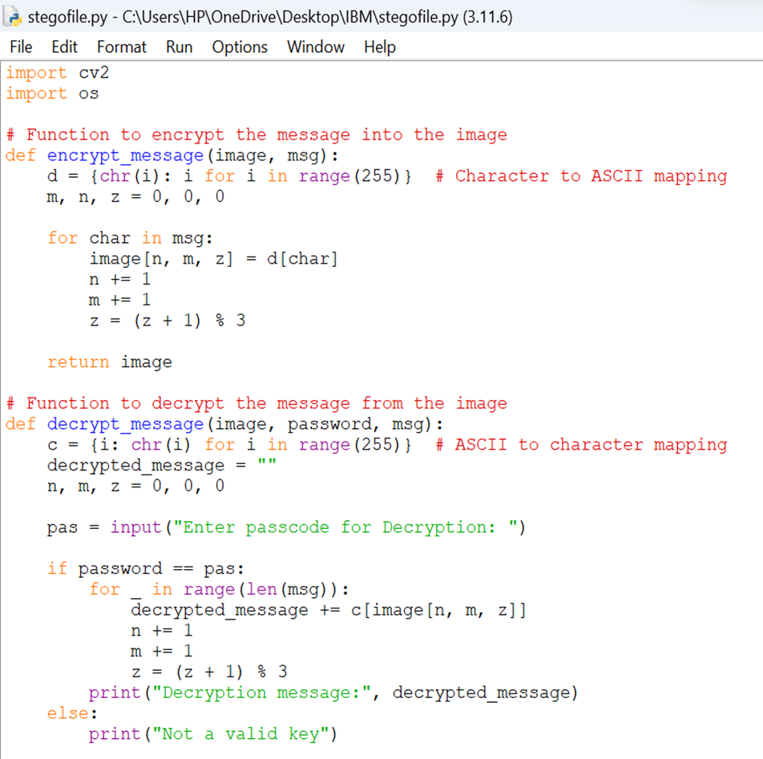
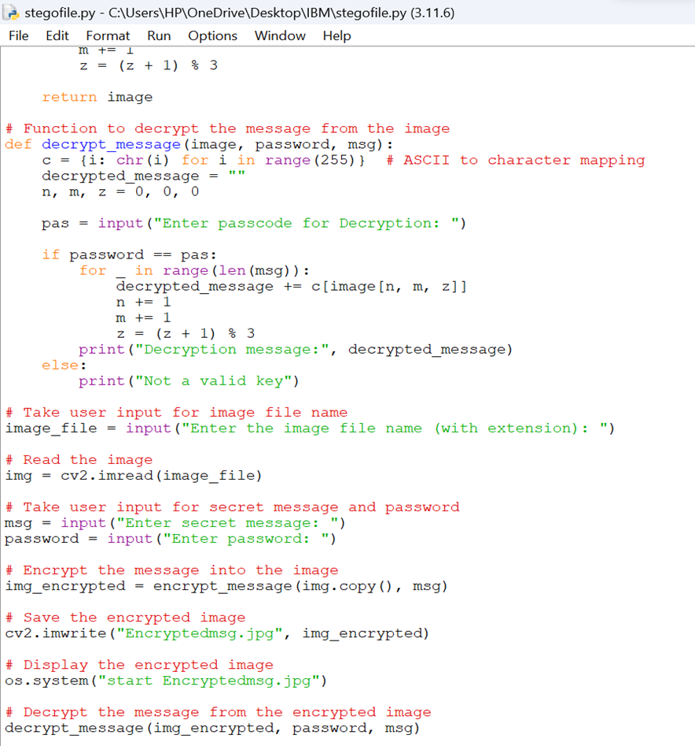
How did you customize the project and make it your own

Slide 9
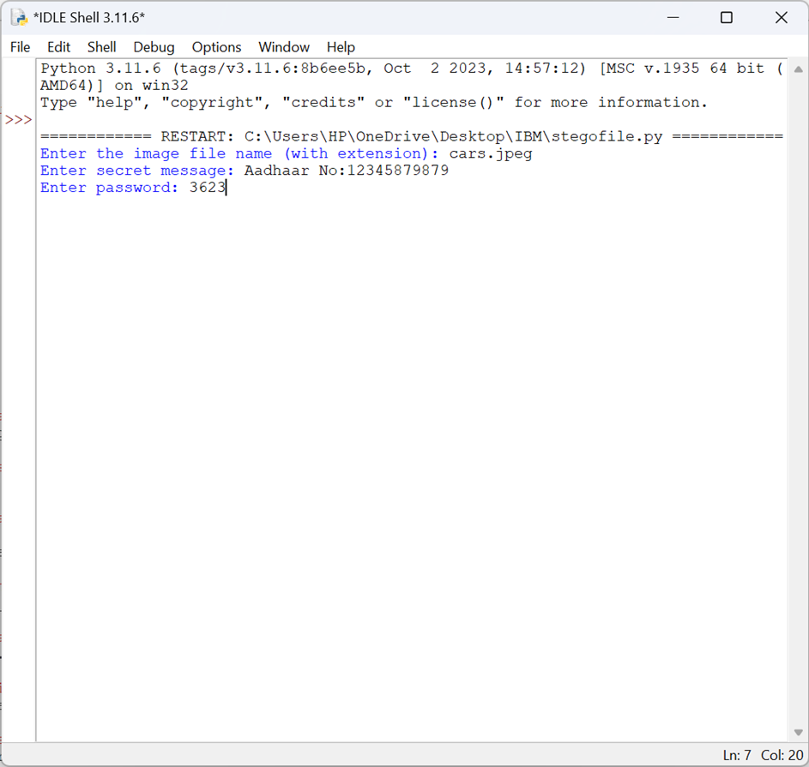
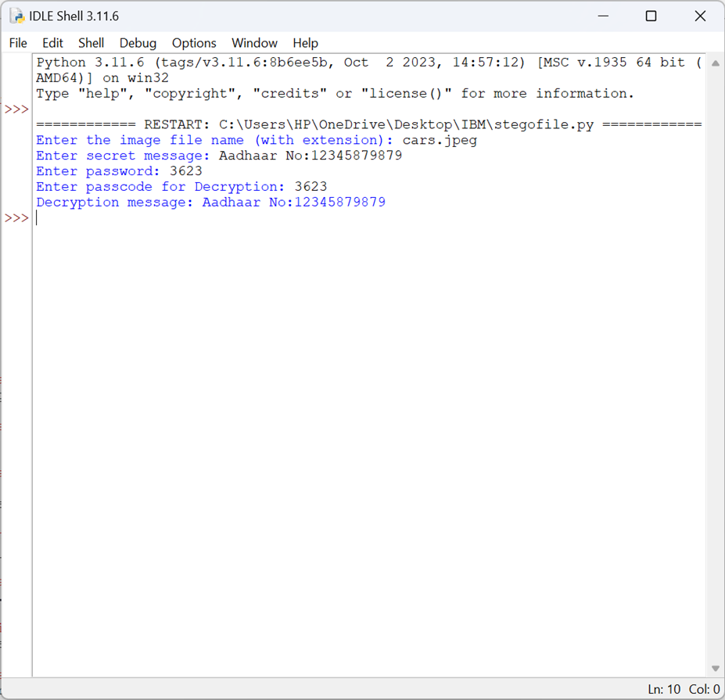
Results

Slide 10


IMAGES
Original Image
Encrypted Image

Slide 11
links
Here you can check the code that I had posted it in my “Git Hub Account”.
https://github.com/harshapriya2745/stegnography.git

